Slide 1


Introduction to Facebook
An expansive social media platform connecting billions of people worldwide.

Slide 2
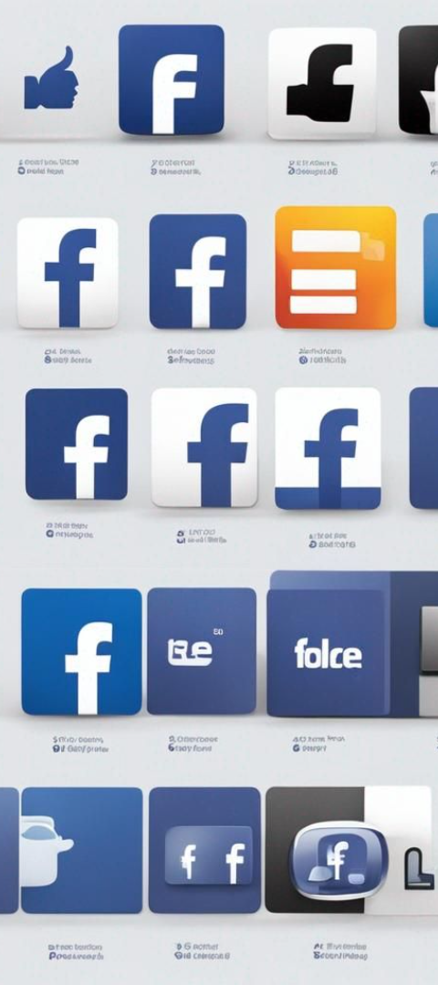
History of Facebook
1
Founding
Founded by Mark Zuckerberg and others in a college dormitory.
2
Rapid Growth
Expanded from a dorm room project into a global phenomenon.
3
Milestones
Acquisitions of Instagram and WhatsApp among other key developments.

Slide 3
Facebook's Mission and Values
1
Connectivity
2
Transparency
3
Innovation
Empowering people to build communities and bring the world closer together.
Commitment to openness, honesty, and privacy for users.
Constantly evolving to improve user experience and stay ahead of trends.

Slide 4
Facebook's User Base and Demographics
Diverse Global Audience
Demographic Insights
Users from all age groups, backgrounds, and regions, making it a truly global platform.
Detailed demographic data enabling targeted marketing and content delivery.

Slide 5

Facebook - Mission and Vision
Facebook's mission is to give people the power to build community and bring the world closer together.
Based on the company’s social media service offerings, Facebook's corporate vision statement is “People use Facebook to stay connected with friends and family, discover what’s going on in the world, and share and express what matters to them.”
This corporate vision demonstrates that the company is more than just an online social networking service. Rather, the firm aids in the gathering of information and meaningful dialogue among individual customers.

Slide 6
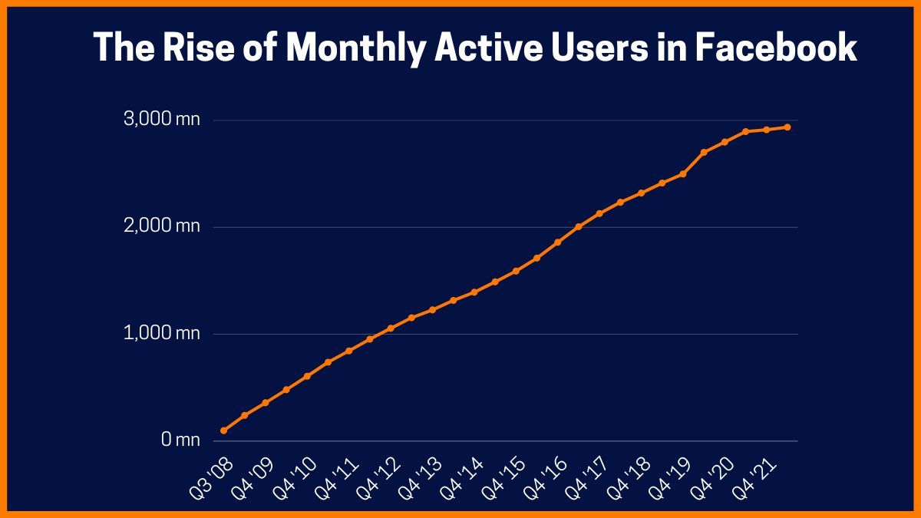
Facebook - Growth
Facebook is the most popular social media network in the world, with 2.91 billion active monthly users as of the fourth quarter of 2021, which went up to become 2.93 bn in Q1 of FY22. Here's a look at the rise of Facebook's monthly active users.

Slide 7
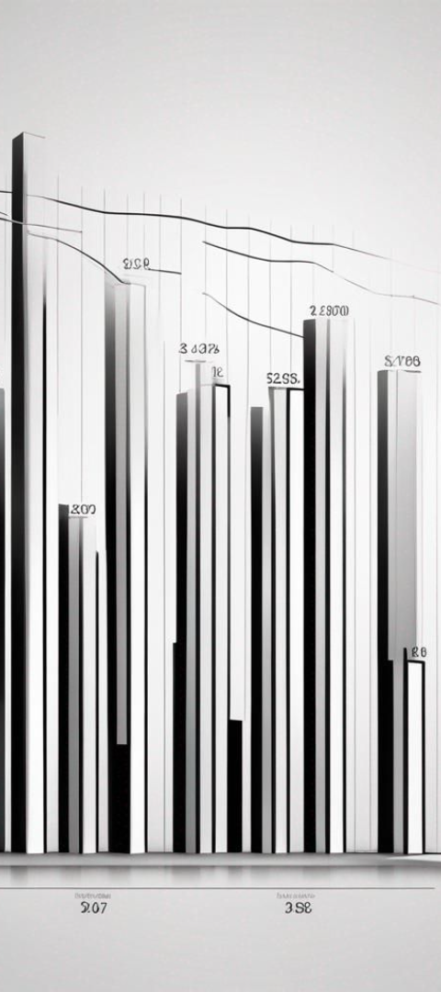
Facebook's Revenue Streams
Advertising
Virtual Goods
Main source of revenue, leveraging user data for targeted ads.
Sale of virtual items for games and other applications on the platform.
Payment Fees
Fee from developers utilizing the platform for payment processing.

Slide 8




Facebook's Impact on Society
Global Connectivity
Dissemination of Information
Socio-Political Influence
Connecting people worldwide, fostering communication and understanding.
Enabling the rapid spread of news, knowledge, and social causes.
Shaping public opinion and activism, playing a role in social movements.

Slide 9
Challenges Faced by Facebook
1
2
3
Data Privacy
Misinformation
Regulatory Scrutiny
Addressing concerns about user data privacy and protection.
Combatting the spread of fake news and harmful content.
Dealing with increased oversight and regulatory challenges.

Slide 10
Facebook - Future Plans
Following the renaming of Facebook as 'Meta,' the firm will be "metaverse first," according to CEO Mark Zuckerberg, which means you won't need a Facebook account to access other Meta products in the future.
“I’ve been thinking a lot about our identity as we begin this next chapter,” he said. “Facebook is an iconic social media brand, but it just doesn’t encompass everything that we do.”
It also suggests that the company would divide its activities into two segments: one for its future platform efforts (Reality Labs is going to be the tag for that segment) and another for its app family.
Whilst expanding their 2 or others. social networking applications will remain a priority, he believes that the company's identity will become less tied to a single product/ service over time.
In short, the metaverse will be an embodiment of the internet, according to Zuckerberg, who believes it will be the next integrated virtual media to emerge after video (which evolved from photos and texts).
Rather than staring at a screen, you'll be able to immerse yourself in these activities. That's most probably to be accomplished through instilling a strong sense of presence in a shared environment, which would be the metaverse's distinguishing characteristic. This will demand hardware from the firm, such as the Oculus Quest
The firm is thinking about offering incentives to developers and new users to join. To boost adoption, these alternatives include cutting costs, subsidizing gadgets, or selling them at a loss.
It's crucial to stress, though, that the metaverse of Zuckerberg's visions is far from complete. Currently, just the fundamental building pieces work, according to Zuckerberg. In the end, technological obstacles remain—compressing augmented reality technology and sophisticated computers into a pair of spectacles, for example, is a difficult task.
Although Zuckerberg vows to encourage security and privacy on this new "social technology" network in a founder's letter, it remains to be seen if he can persuade people to use it, particularly younger generations who have been abandoning Facebook. Many people question if a new interface would simply reintroduce the same old issues.

